Slide 1
CHATBOT FOR
DATA STRUCTURES
MONISHA B T - 21Z320
SHANMITHA P - 21Z346
SHRINIDHI DINESH - 21Z353
SUPRIYA K - 21Z360
VEDAVARSHINI A - 21Z368

Slide 2
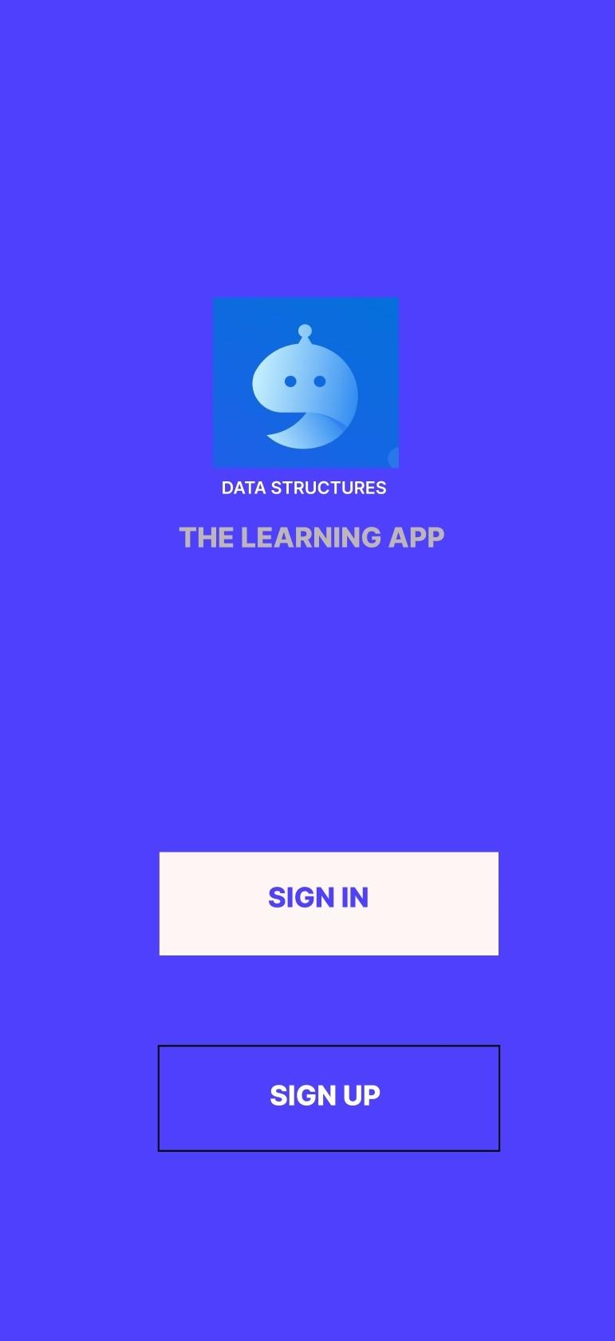
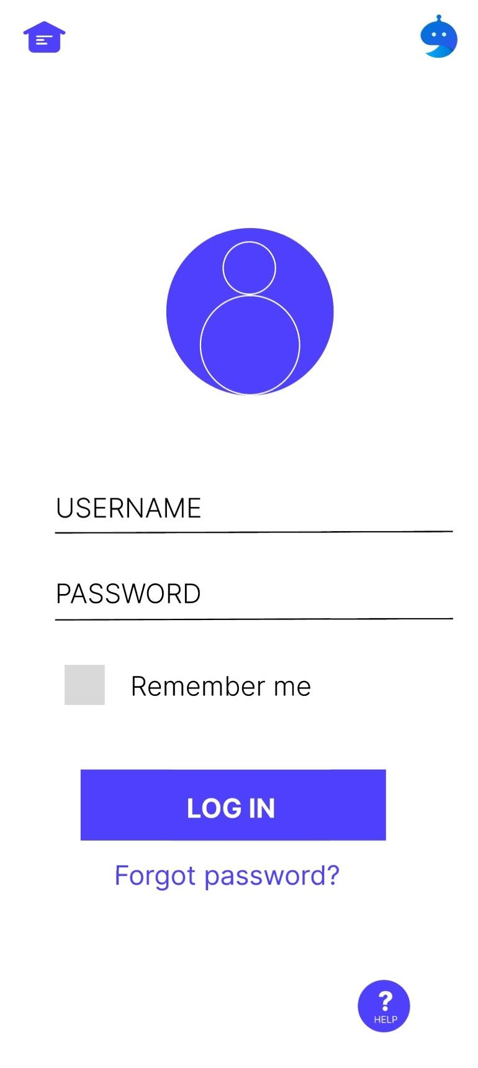
INTERFACE
FIGMA LINK -
https://www.figma.com/file/rlNcrmpAmDupzFpYhZGlzm/CHATBOT-Data-Structures?node-id=0%3A1&t=LF00XTDh2jySb2Op-1

Slide 3
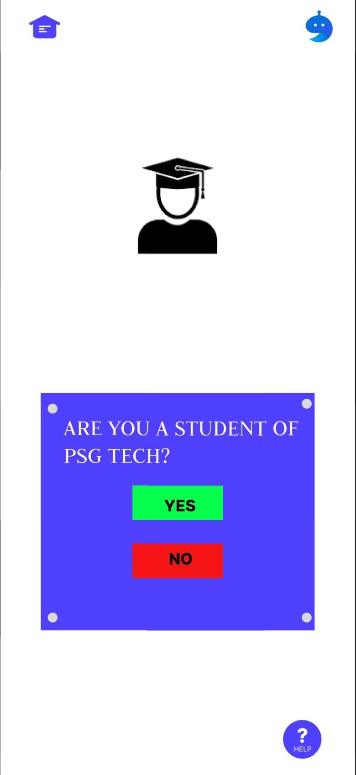
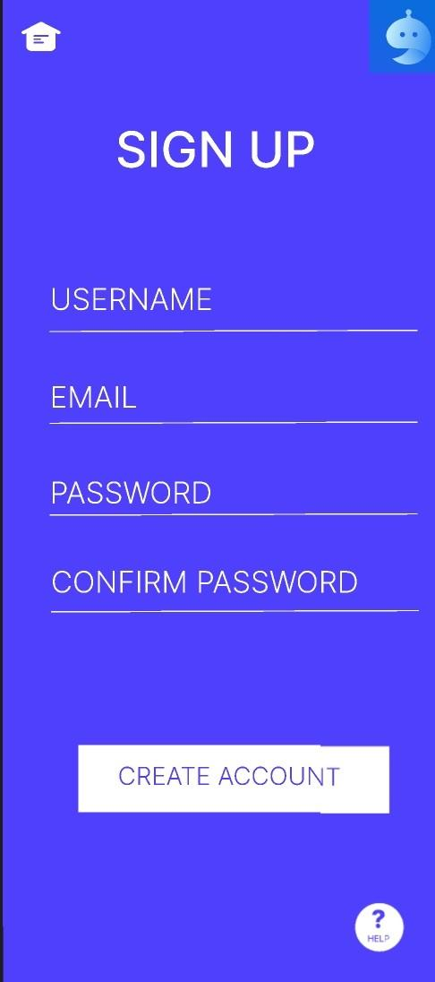

Slide 4
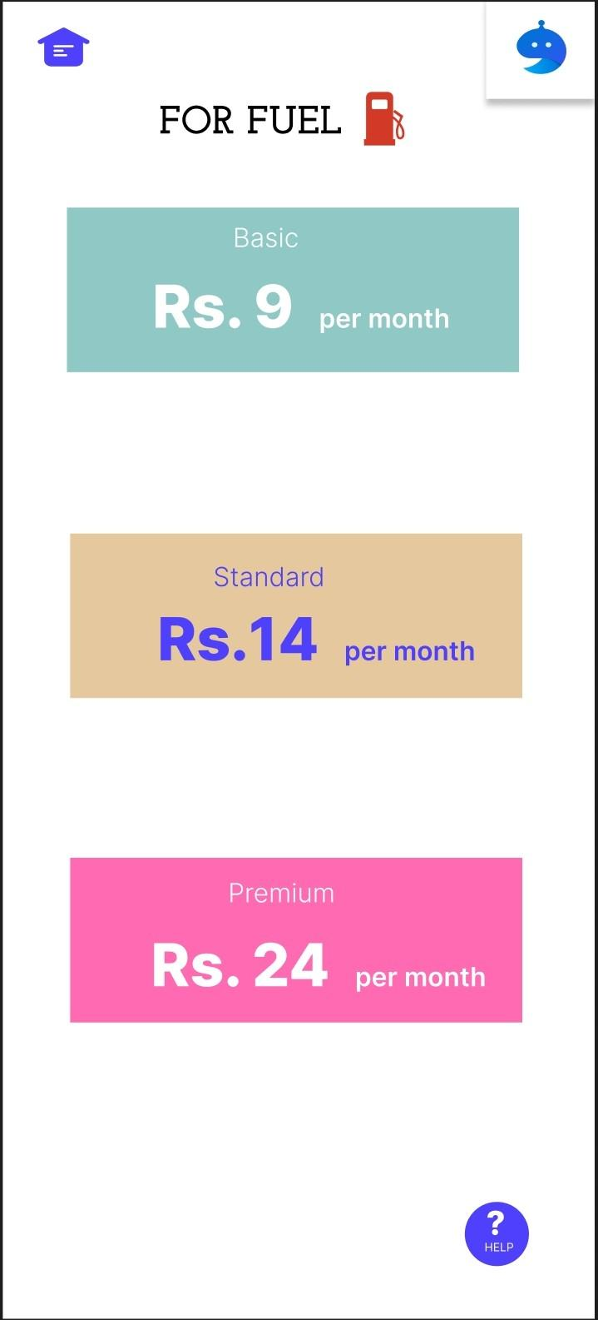
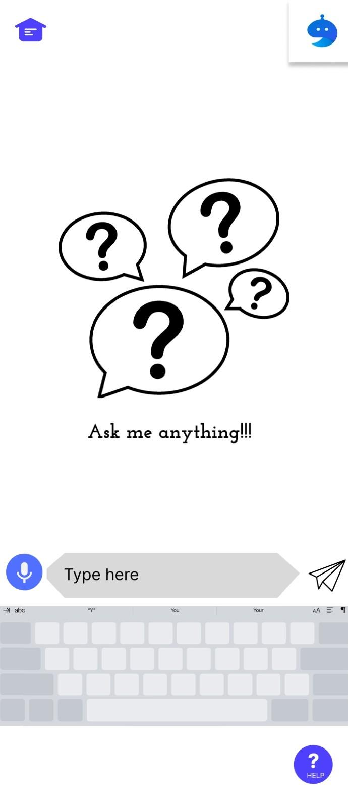
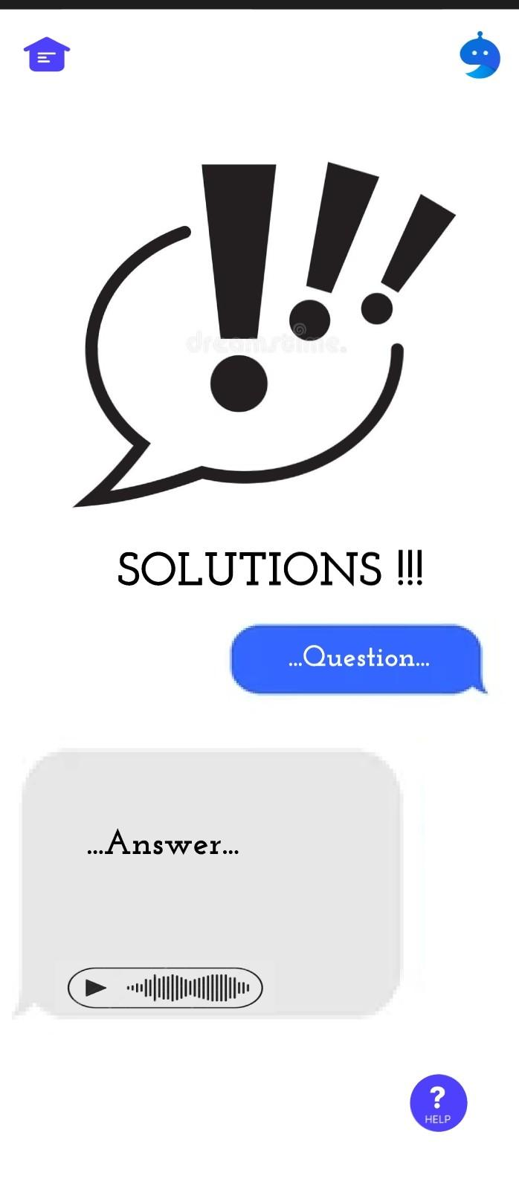

Slide 5
- Thank you -

